Slide 1
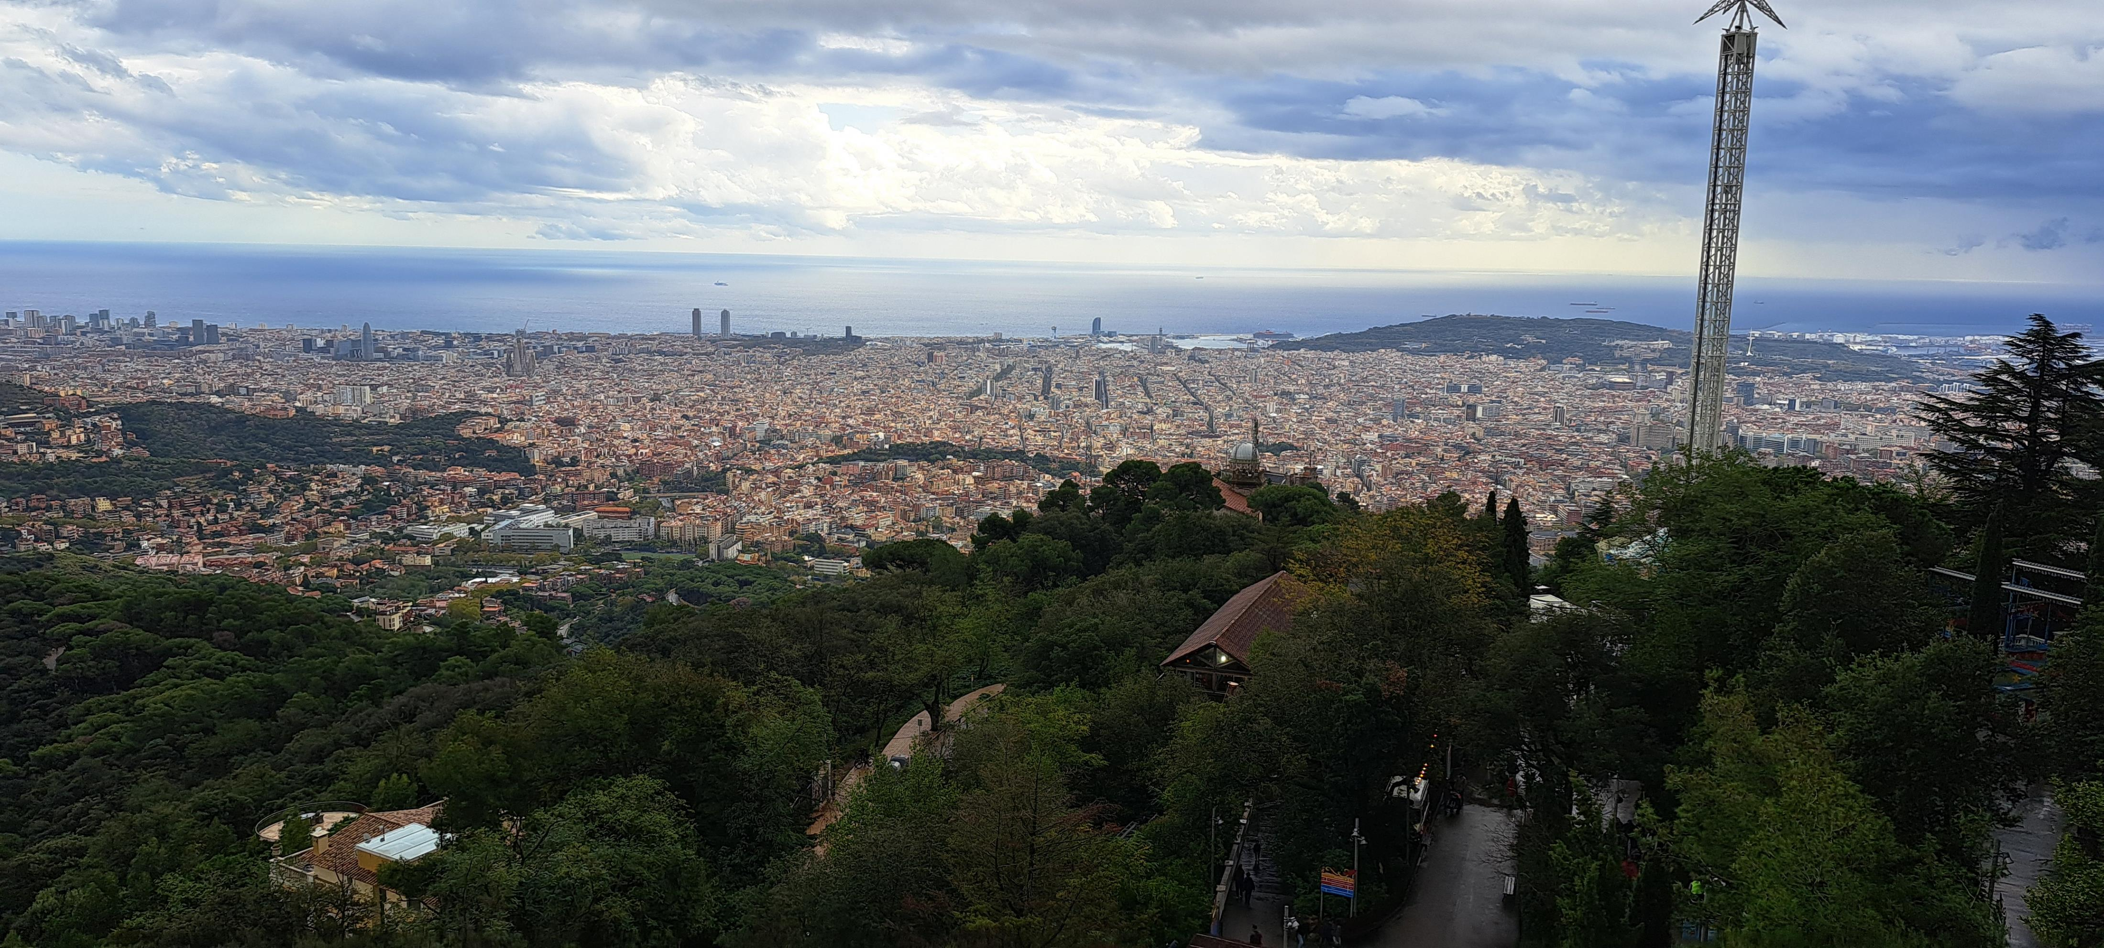
Barcelona- Europass Teacher Academy by Zsuzsanna Gorzóné Terenyi
2024.10.28-11.01.

Slide 2
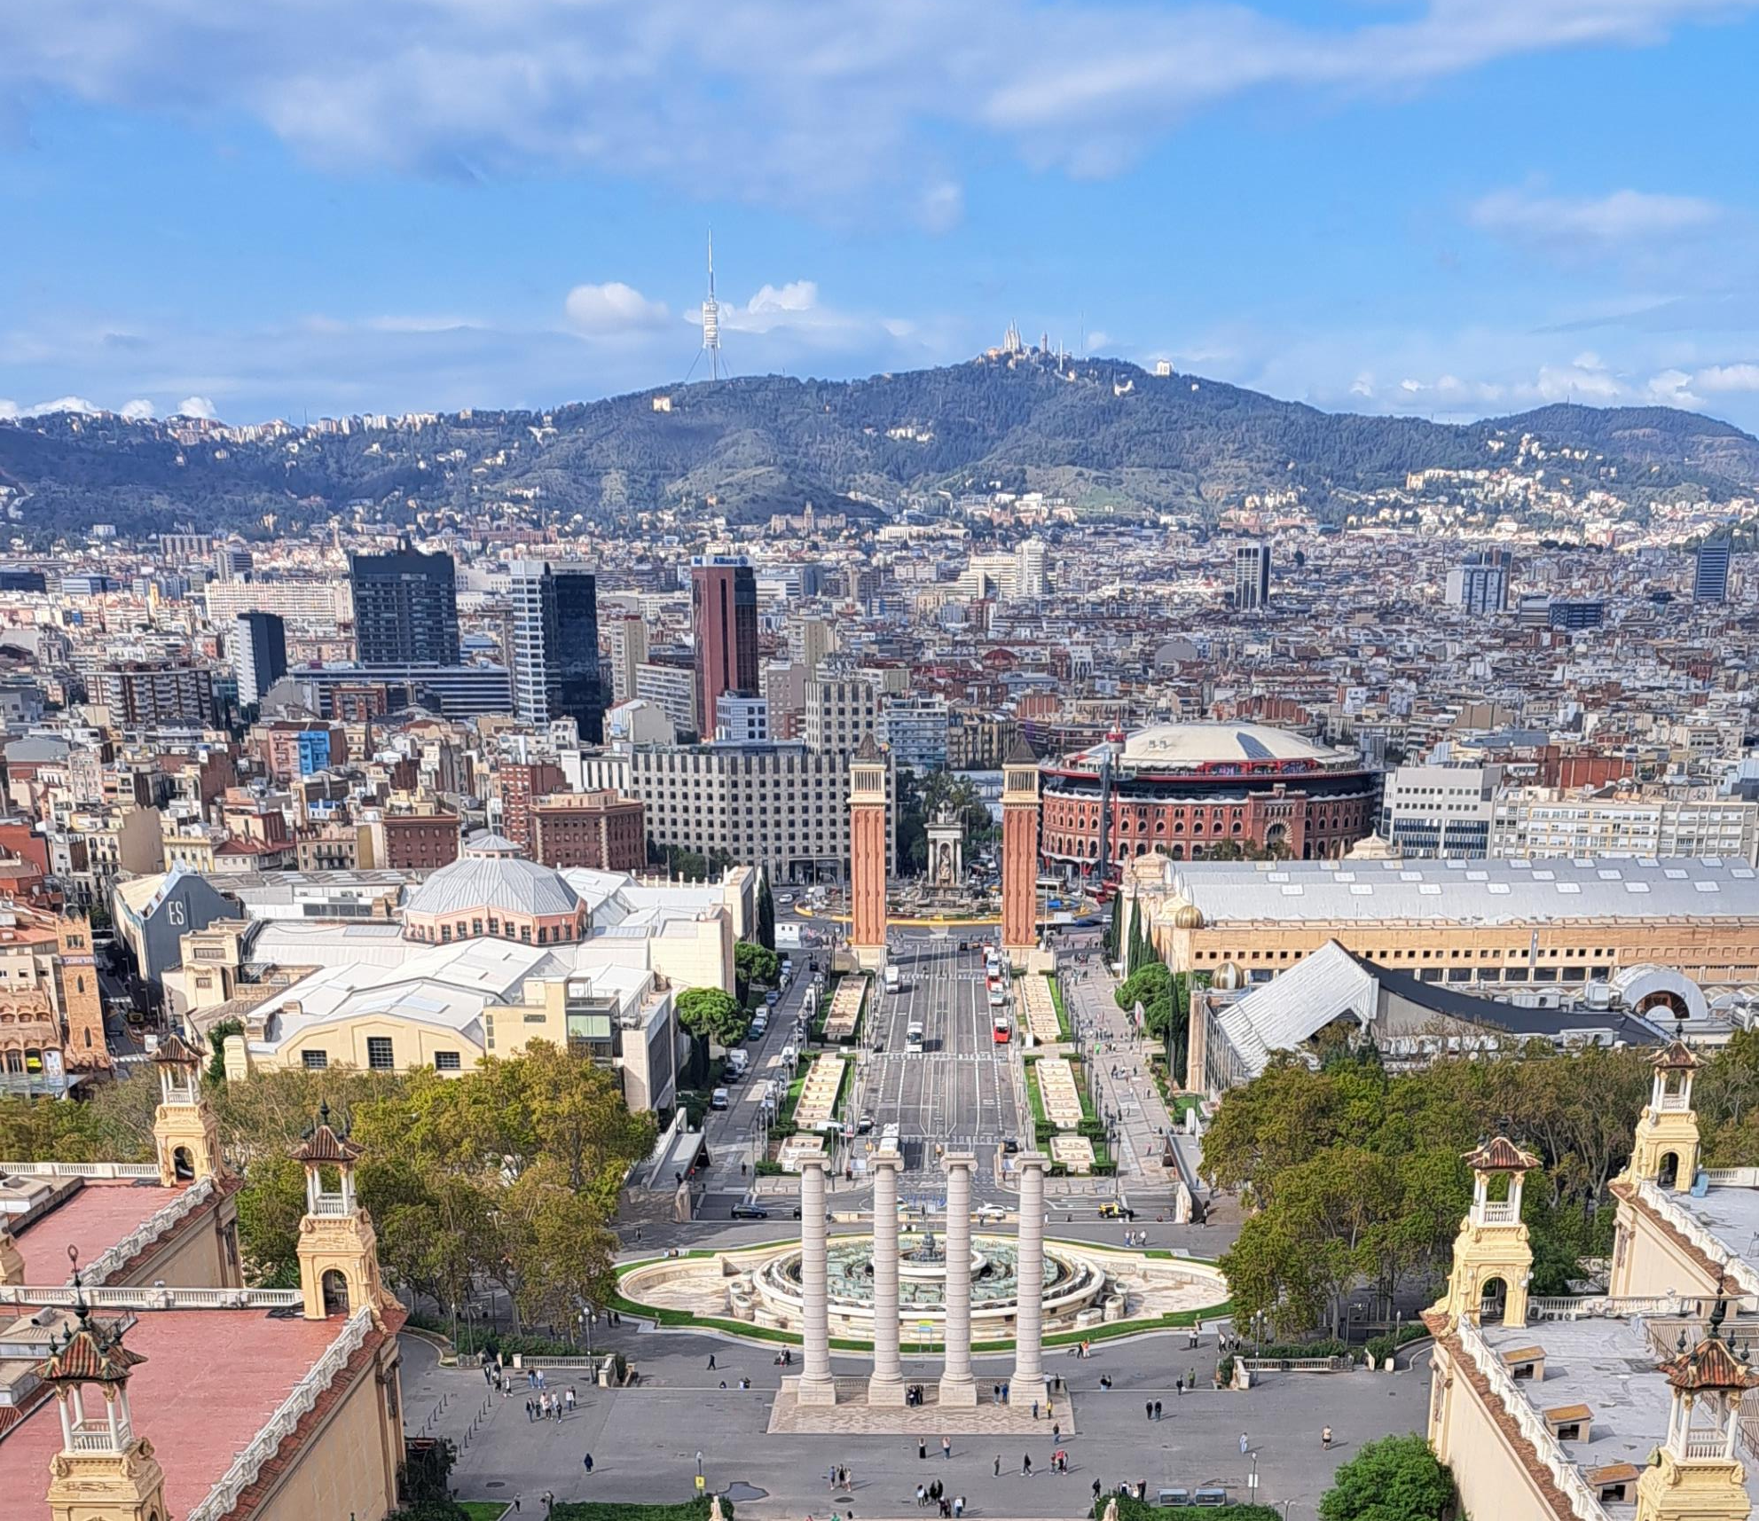
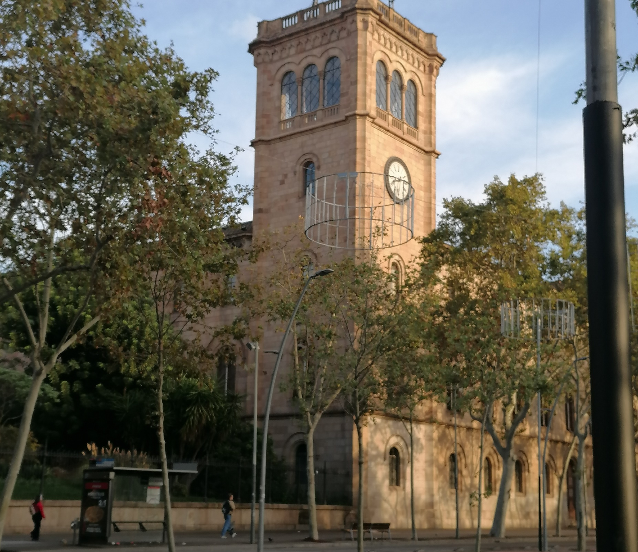
CLIL and PBLL to Improve Student Engagement

Slide 3
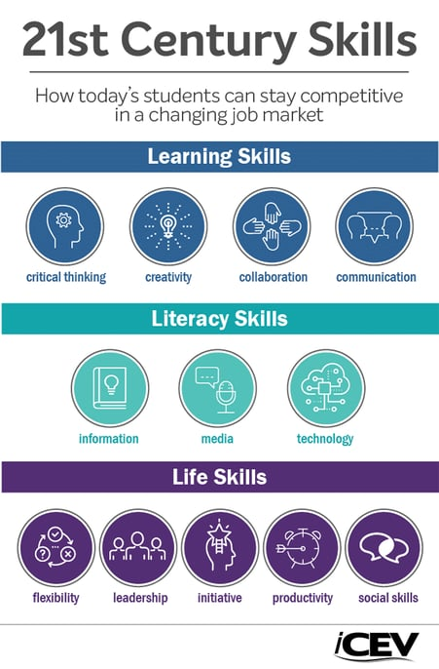
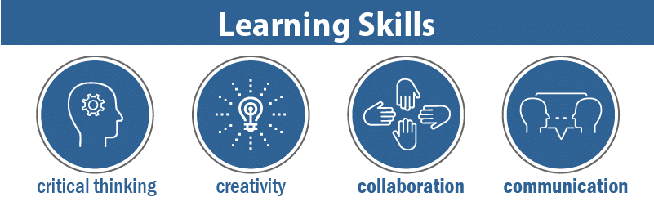

Slide 4
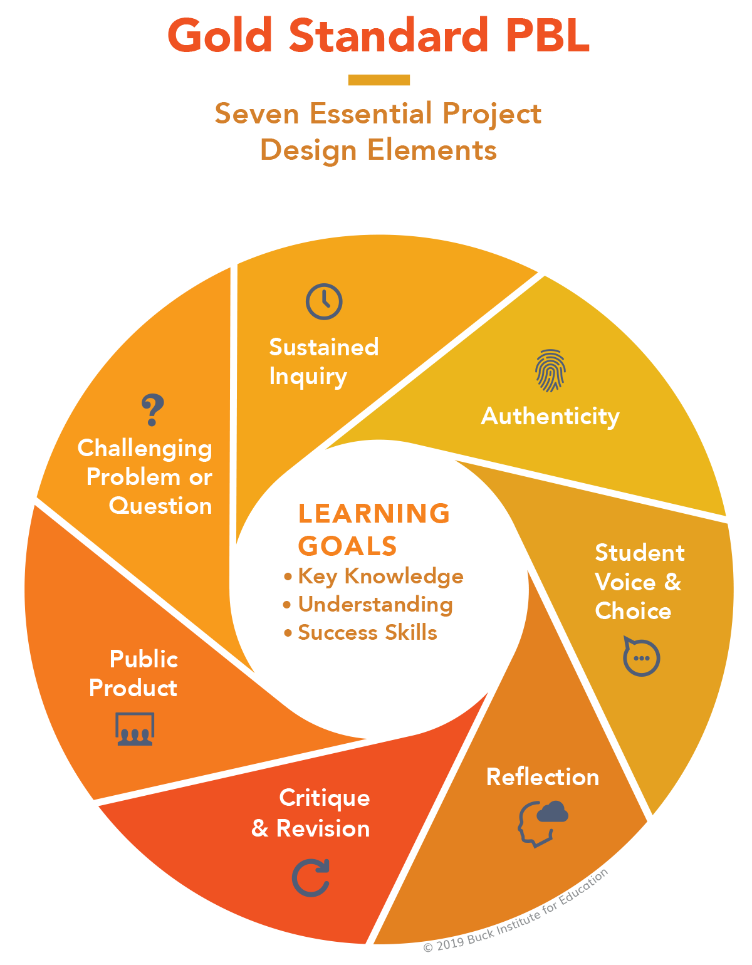
PBLL: Projekt based language learning

Slide 5
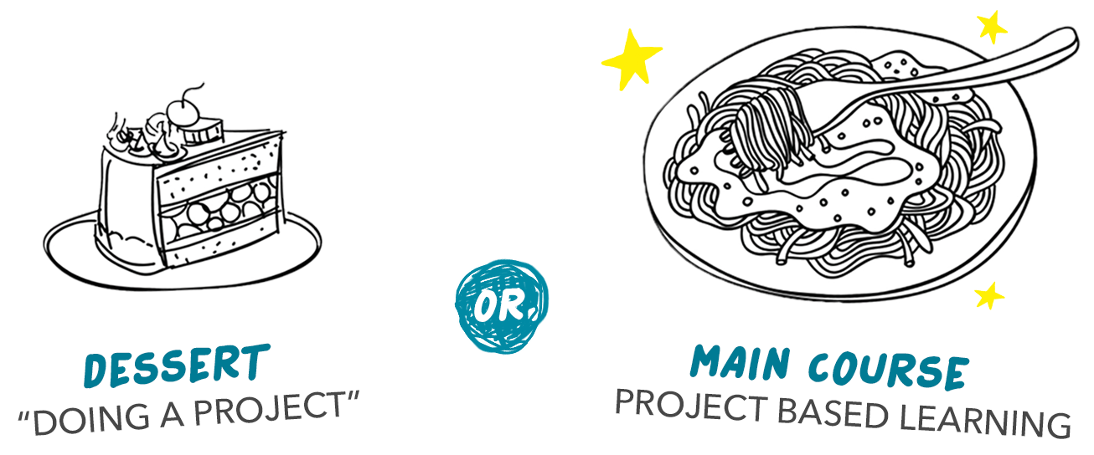

Slide 6
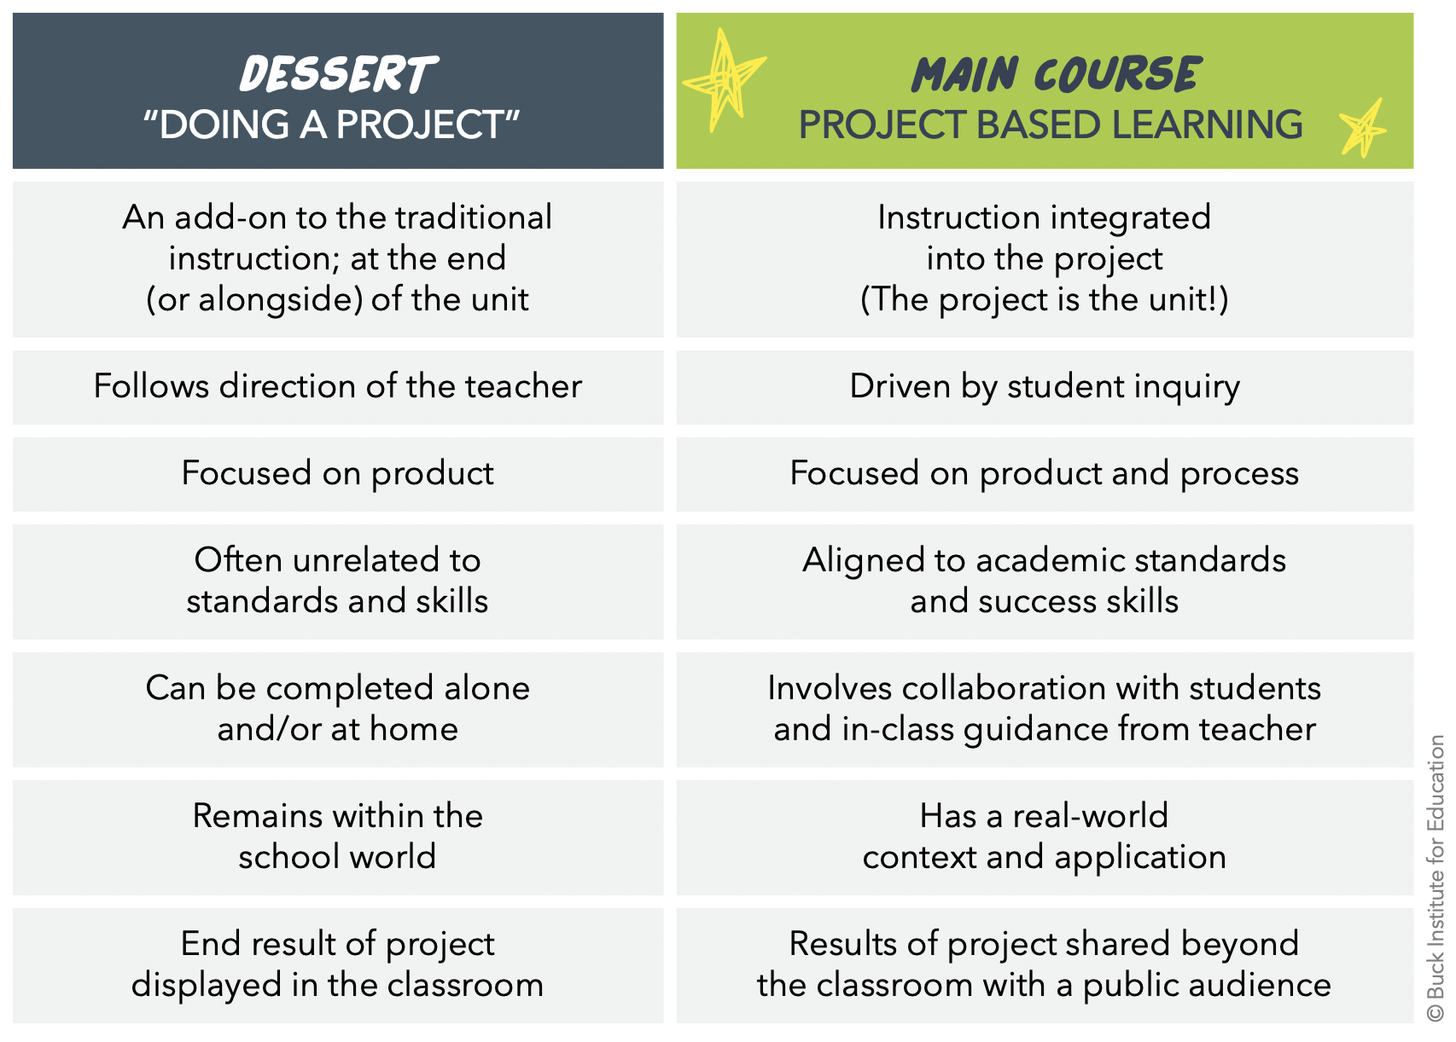

Slide 7
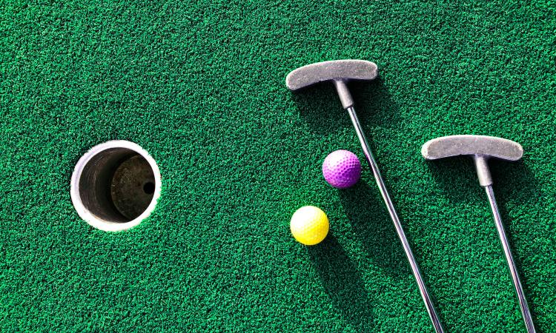
Mini Golf Masters
How can we use geometry to design an appealing and challenging mini golf course?
Grade: 4
Lesson: Math
Key Content geometry, lines, angles, informational writing
Students apply their knowledge of lines, angles, and shapes to create a themed mini golf course that can be played by other classes and invited guests. This project will not only reinforce geometry concepts of points, line segments, lines, rays, and angles, but will also enhance their collaborative and communicative skills. The final Mini Golf Masters Tournament will celebrate student learning and promote pride in the school community.

Slide 8
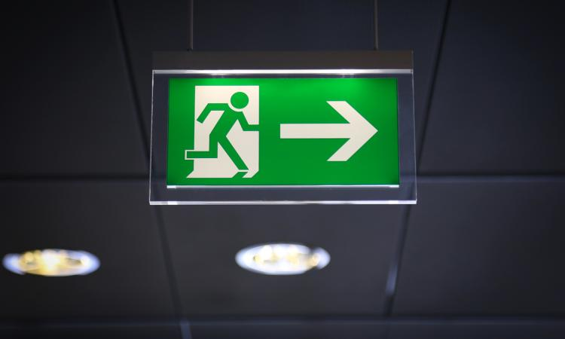
Getting to Safety
In case of a fire, what is the best way to safety?
Grade: 2
Subjects: ELA, Math
Key Content: measurement, fire safety, communication and creativity skills
Students make a fire exit route for their homes and school using research skills and measurement concepts. They review existing school exit plans, gather input from various resources and experts, and engage in inquiry about exit routes and different units of measurement. Project teams create fire exit routes for different locations around school and present their plans to school members, local fire fighters, and/or members of the community.

Slide 9
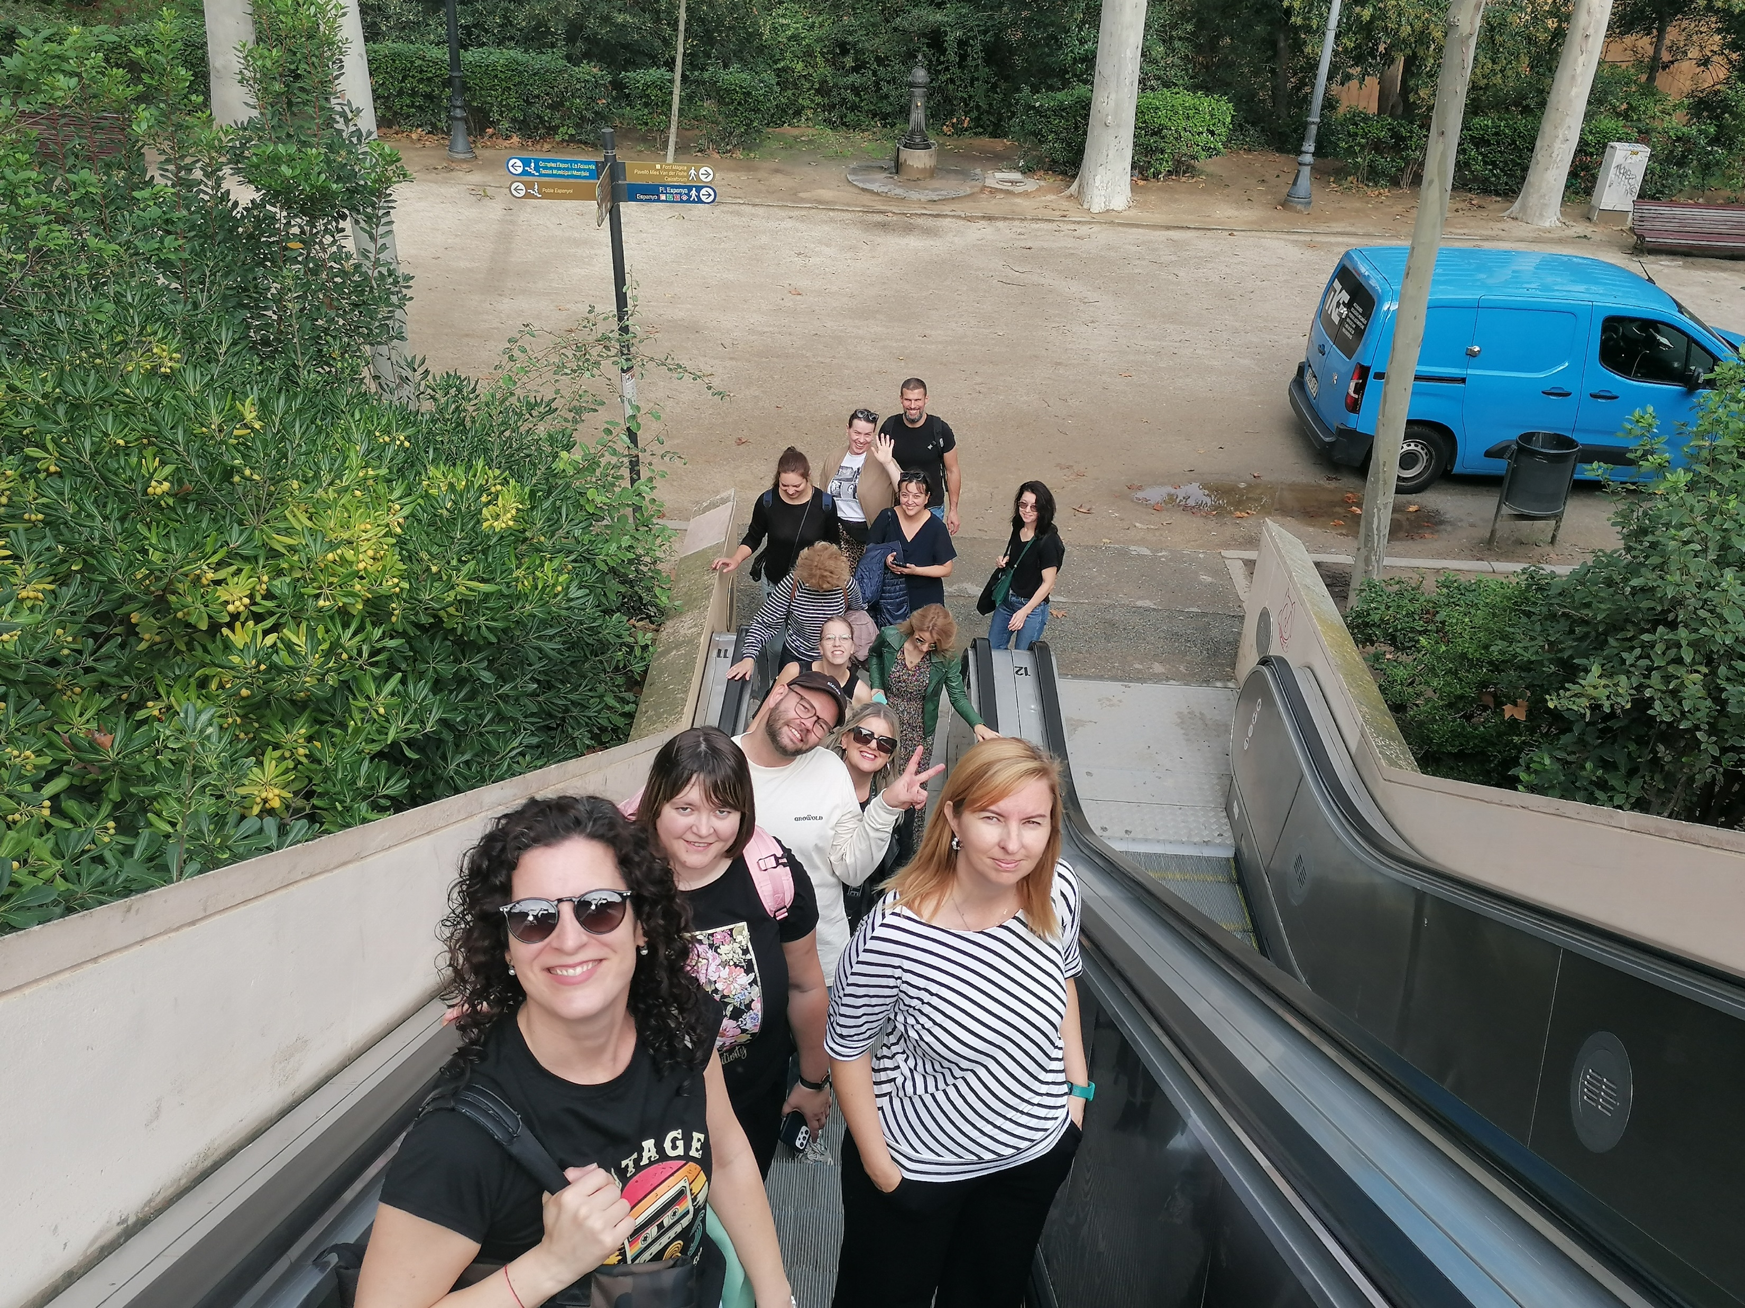
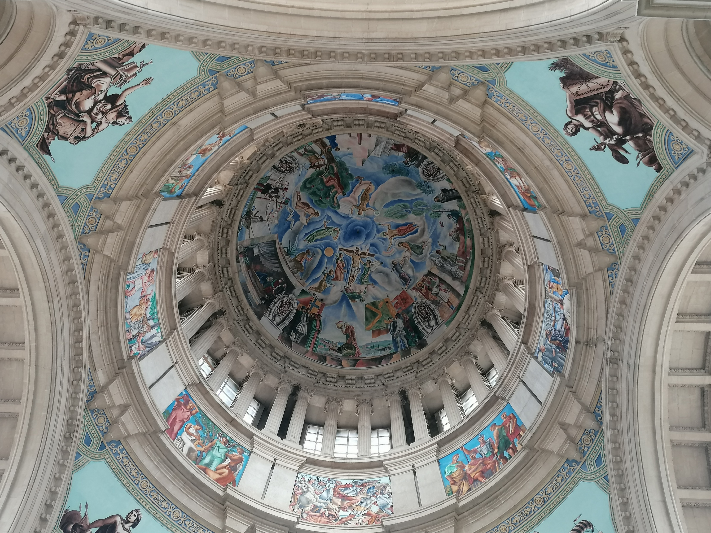
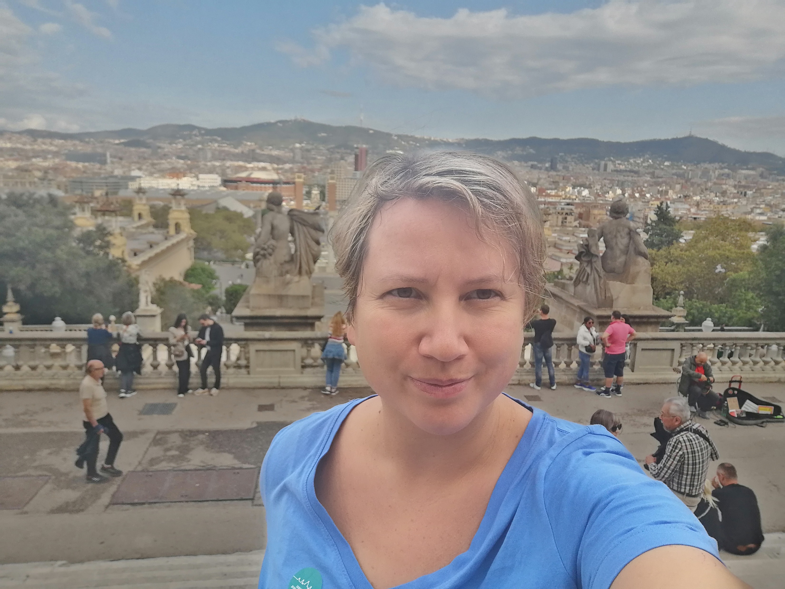
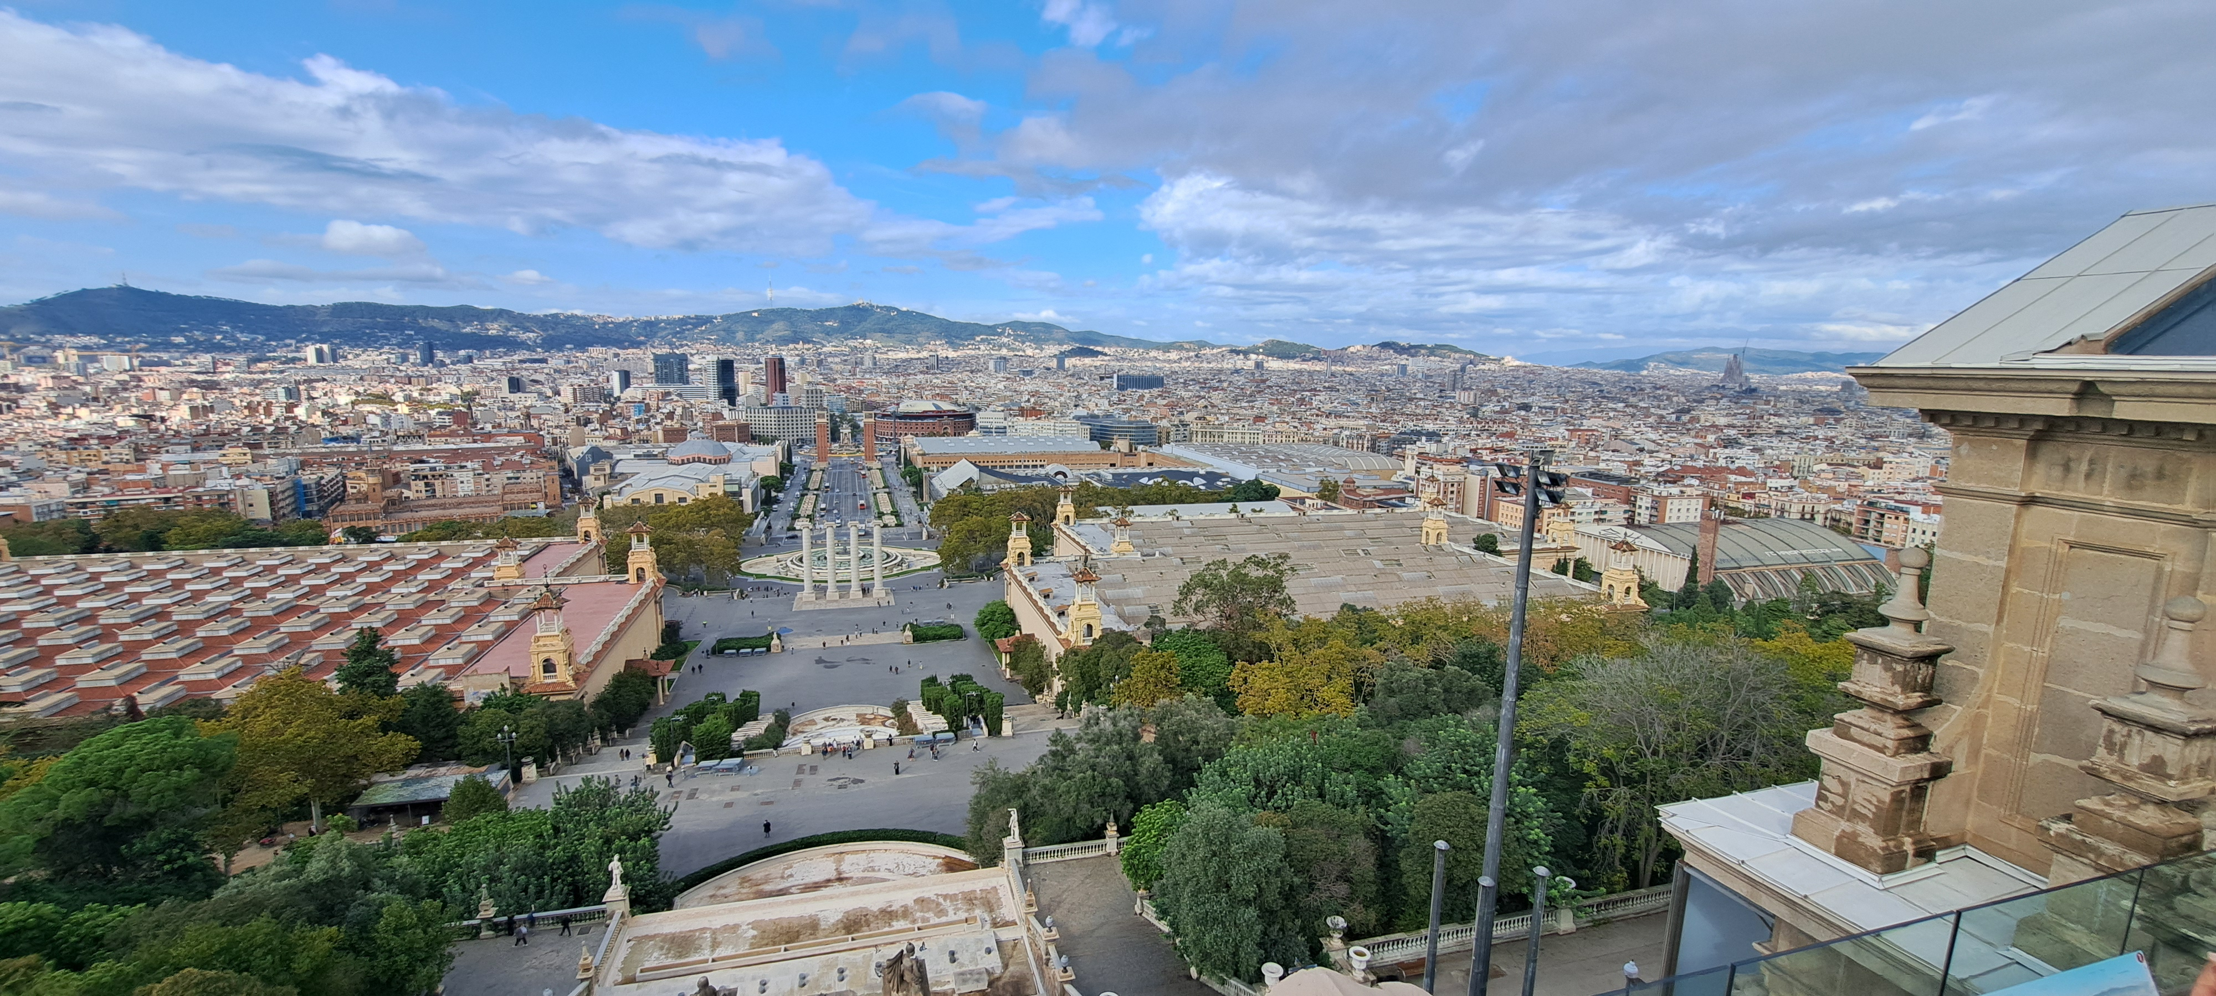
Cultural activity
Museu Nacional d'Art de Catalunya (MNAC)
https://www.museunacional.cat/

Slide 10
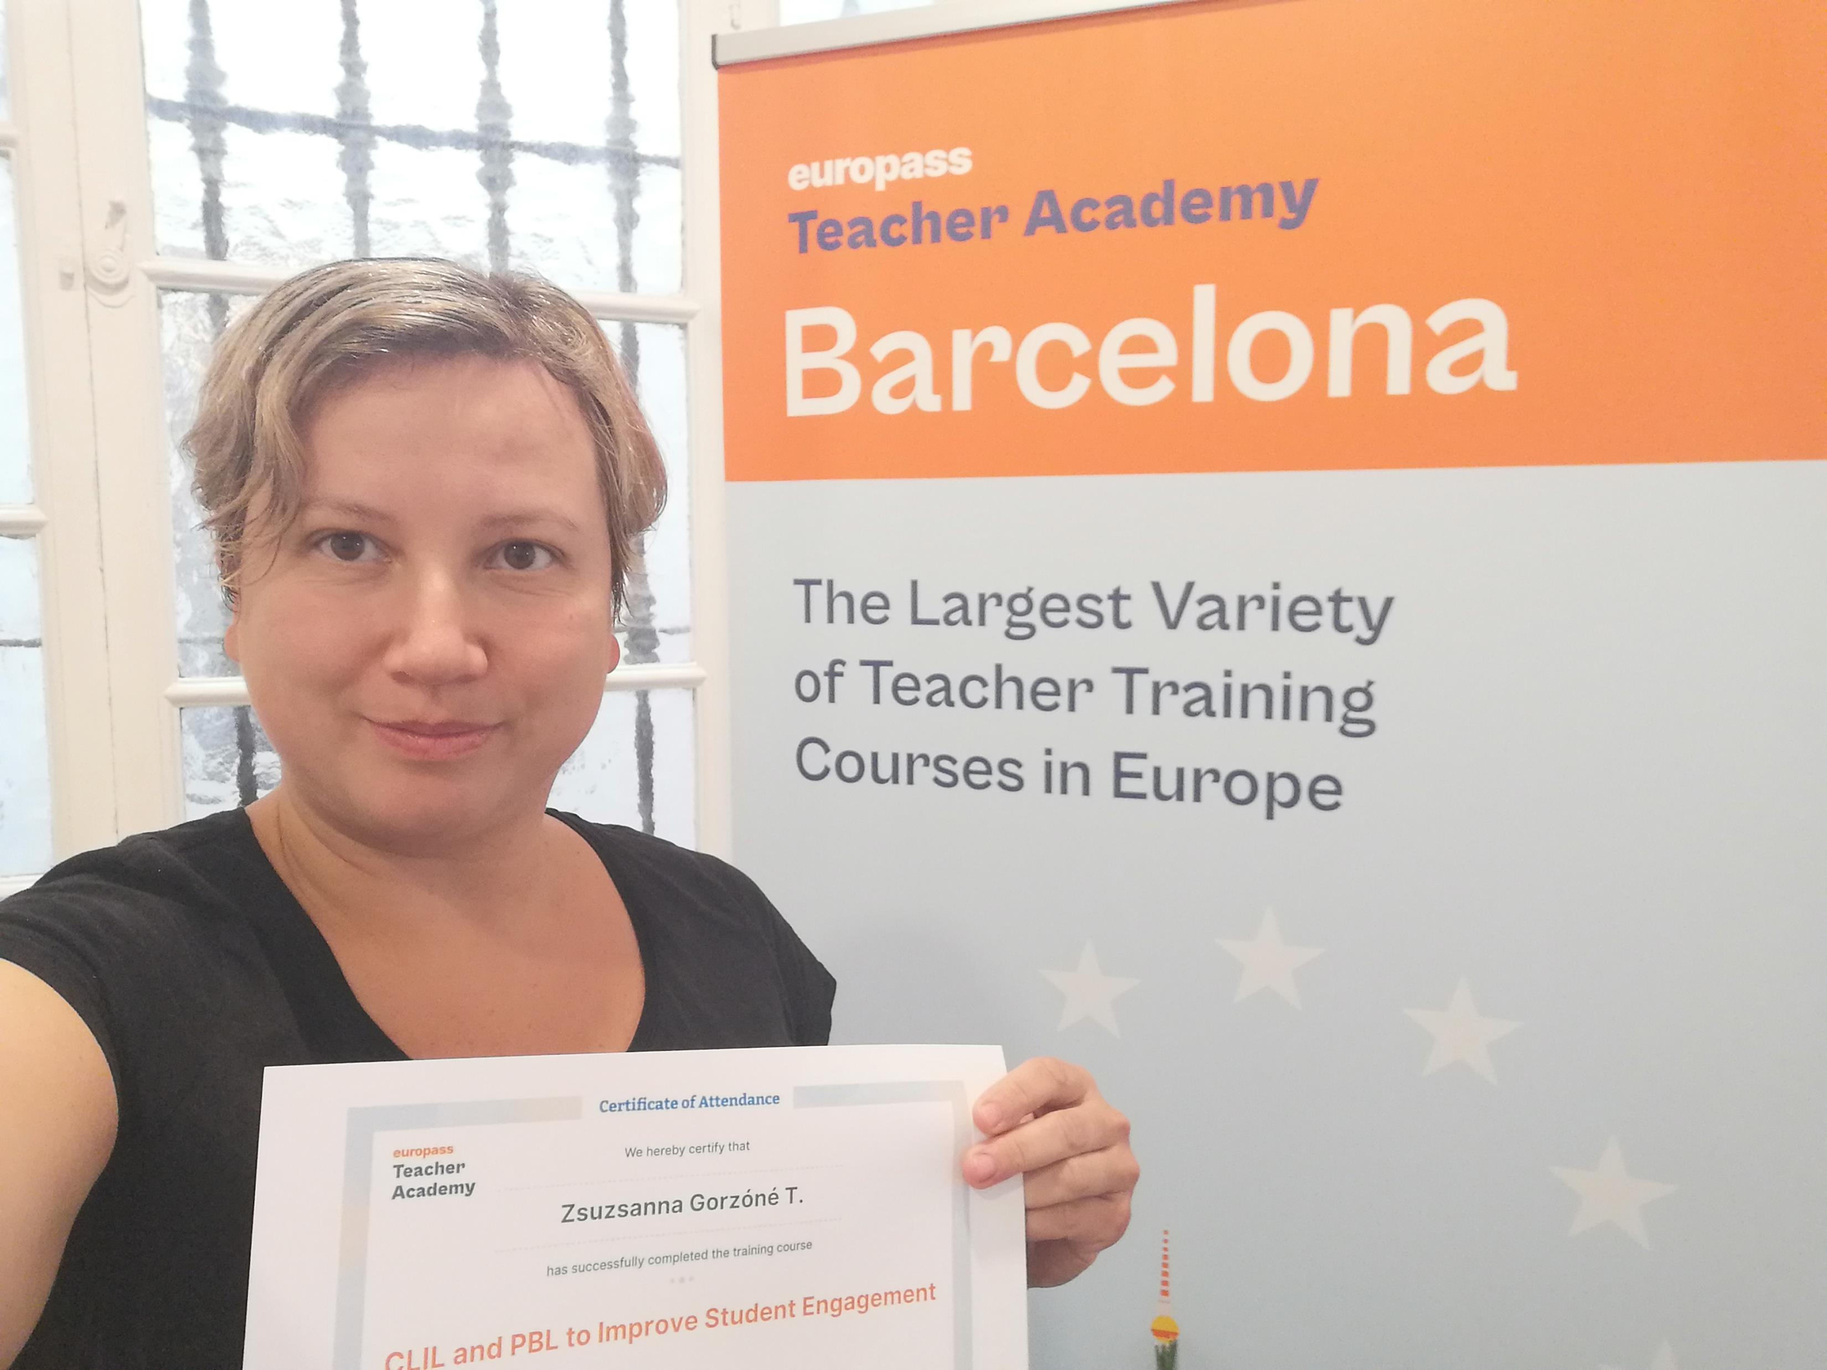
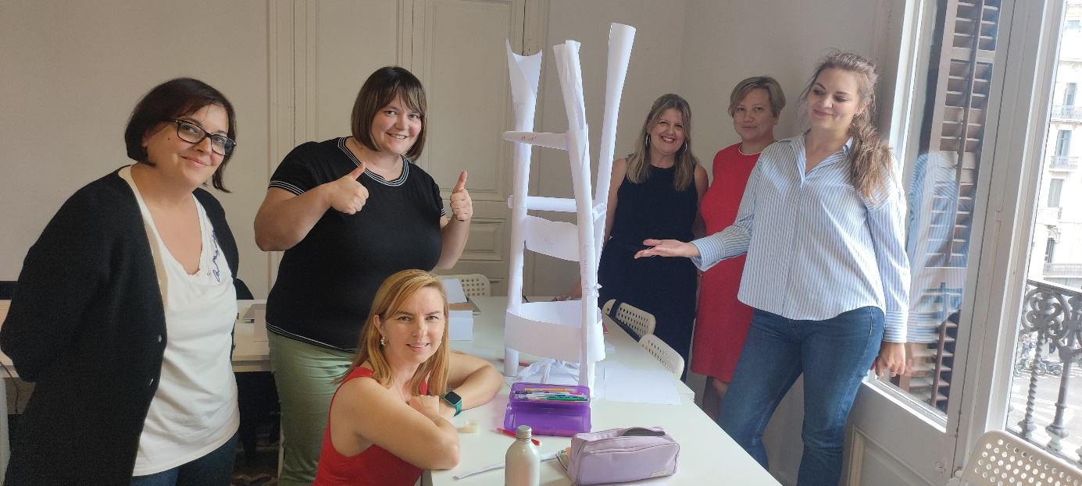
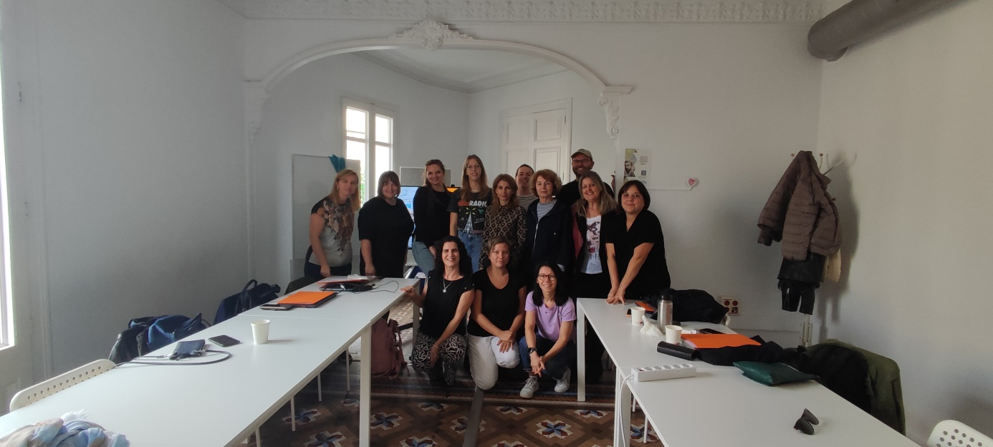
Thank you!

